Slide 1
Module : OP&E Tools
Operational Planning

Slide 2
Objectives of this module
After this module, you will be able to
  Understand how the TME applications support the BP processes for Operational Planning
  Create Clusters in Siebel Marketing and use them in Siebel Sales CG
  Create and manage territories, operational objectives, trade marketing activities, visit activities and visits in Siebel Sales CG
  Monitor field force efficiency en effectiveness in Siebel Analytics
Notes:
Review key objectives as documented on the slide with your participants.

Slide 3
Table of contents
Introduction to Better Practices for Operational Planning
  Definition
  Process Overview
  Capability Interdependencies
Tool support for Operational Planning processes
  Tool support
  Tool step overview by BP process
  Tool steps in detail
  Tool demo
  Exercises

Slide 4

Operational and Execution Capabilities
Operational Planning - Definitions
Operational Planning:
  Operational Planning is designed as both a planning and a supporting function, ensuring that every individual within the Trade Marketing execution arm is aware of, and effectively working towards the Consumer and Trade Marketing objectives/guidelines .
  Through this capability, activities of the Field Force are coordinated and prioritized. Internal and external resources are deployed accordingly. Defining which locations to contact, by which type of representative, at what frequency and for what purpose is coordinated and communicated to the ‘execution arm’ through this capability.

Slide 5
Operational and Execution Capabilities Operational Planning – Process Overview
Process Overview
Process Description
Gather & consolidate ASP, market/customer & consumer insight
Gather, consolidate and analyze information on markets, customers and consumer insight.
I1
I1
Determine visited JTI universe and prioritize outlets into clusters per targeted segment
Determine the outlet universe to be analyzed.
Prioritize segmented outlets to be covered based on fit with JTI objectives.
I2
I2
Determine size of resources and allocate (HR + materials)
Determine how best to deploy sales and trade marketing resources.
I3
I3
Communicate objectives, instructions, guidelines and related incentives
Communicate operational objectives, guidelines, instructions and the related incentives to the trade marketer team through use of targeted instructions and support aids.
I4
I4
Manage 3rd parties
The process of objectives setting and performance control for the outsourced service.
I5
I5
Administer and support sales & service (e.g. training)
Manage the trade marketer group in terms of - scheduled visits, providing support materials, follow up on performance, coaching and skill building.
I6
I6
Evaluate operational planning effectiveness
Actual against operational objectives are proactively monitored throughout the organization.
I7
I7

Slide 6



Operational and Execution Capabilities
Operational Planning – Interdependencies
Brand Marketing
Channel/Segment Mgmt
Account Management
Category
Developer
ASP: Objectives & strategies
(brand, channel, segment and account)
Pricing & trade terms
Competitor reports
Assortment information
Planograms
Promotion plans
Merchandising programs
Performance Criteria
Reports on Trade Marketing Performance
Gather and consolidate insight
1
7
Operational Planner
2
Evaluate Operational Planning effectiveness
Determine JTI universe
and prioritized clusters
Siebel Analytics
Siebel Marketing
Administer and support Sales & Service
6
3
Determine size of resources and allocate
Operational Planning
Siebel Analytics
Visit scheduling
Coaching & Training
Asset Mgmt
Fixed Coverage
Cycle planning
Etc.
5
4
Area/District Mgrs
Manage
third parties
Siebel
Sales
Area/District Mgrs
Communicate
objectives, guidelines
and incentives
Trade Marketers
3rd Parties
Trade Marketers

Slide 7
Table of contents
Introduction to Better Practices for Operational Planning
  Definition
  Process Overview
  Capability Interdependencies
Tool support for Operational Planning processes
  Tool support
  Tool step overview by BP process
  Tool steps in detail
  Tool demo
  Exercises

Slide 8
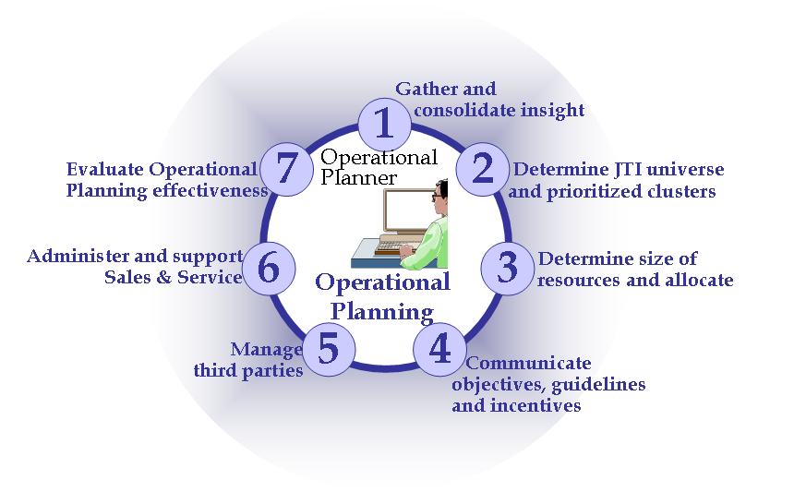
I.1 – Gather & consolidate insight
Tool support
How to gather and consolidate ASP,
market / customer and consumer insight?
Better practice process steps
Input:
From who What
Process
action
Output
Brand Marketing
Channel / Segment /
Account Mgmt
APSP: Objectives & strategies
(brand, channel, segment and account)
Pricing & trade terms
Competitor reports
Gather
insight
Prepare consolidated
instructions for Trade Marketer
Siebel
Sales
Siebel
Sales
Siebel Analytics
Assortment
information
Planograms
Promotion plans
Merchandising programs
Performance Criteria
“Literature Screen”
Category Developer

Slide 9
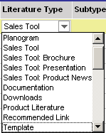
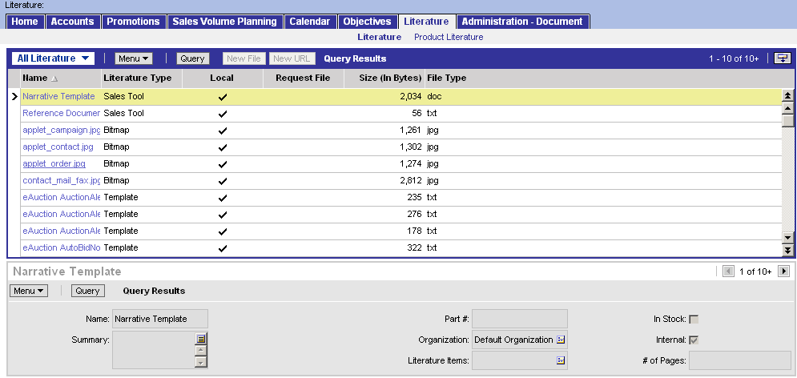
I.1 – Gather & consolidate insight
Store documents in Siebel Sales CG
The operational planner refines ASPs, brand
guidelines, etc. and stores these within Siebel Sales
accessible for the Trade Marketer (read only)
How to store a document in Siebel Sales CG?
  There are two ways to store attachments in Siebel Sales:
    As Attachments to objects, e.g. as attachment to an account (outlet)
    As Literature, which means that the attachment exists without a direct link to other objects
The following file types are
among the most common:
Adobe Acrobat (PDF)
Excel (XLS)
Word (DOC)
PowerPoint (PPT)
Bitmap (BMP)
JPEG (JPG)
JTI values are to be added to classify Literature documents

Slide 10
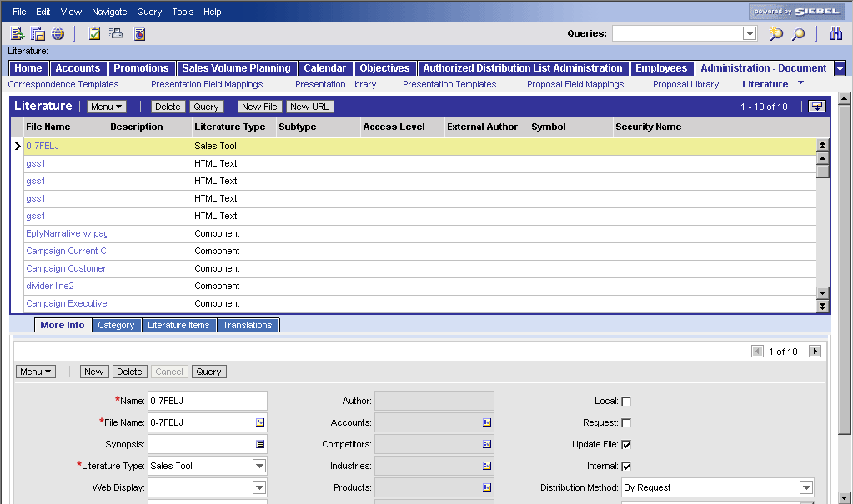
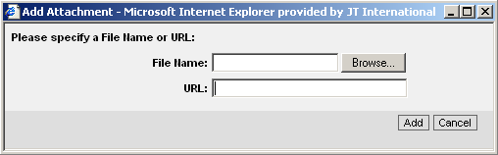
I.1 – Gather & consolidate insight
Store documents in Siebel Sales CG
How to store document in Siebel Sales CG?
  Authorized users will have access to an
  additional screen, ‘Document Administration
  Screen’. In this screen, new documents or updated
  versions of the documents currently stored can be
  uploaded into the system.
Document Administration Screen
Notes:
Are authorized users for this screen Brand Managers, Channel/Segment/Key Accounts Managers, Category Managers, Operational Planners and Area Sales Managers

Slide 11
I.2 Determine JTI universe and prioritize clusters
Tool support
How do you determine the visited JTI universe
and prioritize outlets into clusters per targeted
segment?
Better practice process steps
  Determine Outlet universe to be analyzed
  based on currently available information
  Prioritize segmented Outlets to be covered
  based on fit with JTI objectives.
Determine JTI Universe, Channels & Segments
Siebel Marketing
Load Trade Segmentation outlet attributes
Source of Business
Brand Focus
Brand Opportunity
Visit Frequency
Siebel
Sales
Siebel Sales support for BP process steps
Siebel Marketing Analytics support for BP process steps

Slide 12
I.2 Determine JTI universe and prioritize clusters
Tool support
I.2.1 Determine Outlet universe to be analyzed
based on currently available information
  This BP subprocess is a task for the channel
  manager and segment managers. The in-and
  out criteria, as defined in the Better Practices result
  in a scorecard which will allocate each account in the JTI universe to one channel and one segment. The channel/segment manager is responsible for updating the allocations in the TME tools (Siebel Sales)*
  The operational planner analyses the current and future universe and provides feedback
I.2.2 Prioritize segmented Outlets to be covered based on fit with JTI objectives.
  The channel/segment manager defines the so called Trade Segmentation attributes in close collaboration with the Operational Planner. Once the Brand Focus and Brand Opportunity are defined (on source of business or consumer profile), clusters are created to which certain visit frequencies are assigned. This will have an impact on the composition of the territories (see following processes).
*Training module: OP&E tools – Strategic Capabilities Support

Slide 13
I.2 Determine JTI universe and prioritize clusters
Prioritize clusters
The Better Practice processes describe that prioritizing clusters is based on certain account attributes, such as:
  Source of Business (defined by Trade Marketer)
  Brand Focus (calculated)
  JTI Brand opportunity (calculated)
  Visit frequency (calculated)
In case this data can not be calculated for the targeted universe, the Trade Segmentation attributes are to be defined by the market for each account manually. A loader is available to load this data into Siebel Analytics. (The Brand Focus loader)
A separate training module on the use of the Trade Segmentation ASP pages is available. Please request the deployment team

Slide 14
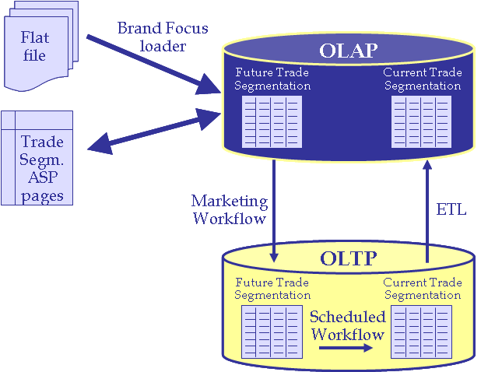
I.2 Determine JTI universe and prioritize clusters
Current and future Trade Segmentation attributes
How are account Trade Segmentation attributes updated in Siebel Analytics and Siebel Sales?
  Attributes are : Brand focus, brand score, customer importance, brand opportunity, visit frequency and visit required
Update Trade Segmentation attributes in OLAP and OLTP
Update the new future values in OLAP
  Load the data from a flat file (AM team)
  Use the TS asp pages to calculate and modify the attributes directly in OLAP (condition: availability of data used to calculate)
Request the AM team to upload the attributes from OLAP to OLTP (incl. JTI univers, channel and segment field)
In Siebel Sales (OLTP) you can compare in the account/more info/trade segmentation view the current and the future values (see next slide). Once confirmed (e.g. at end of year) request AM team to overwrite with a scheduled workflow the current values by the future (next year) values.
The overnight ETL will update the current values in OLAP
1a
1b
2
4
3

Slide 15
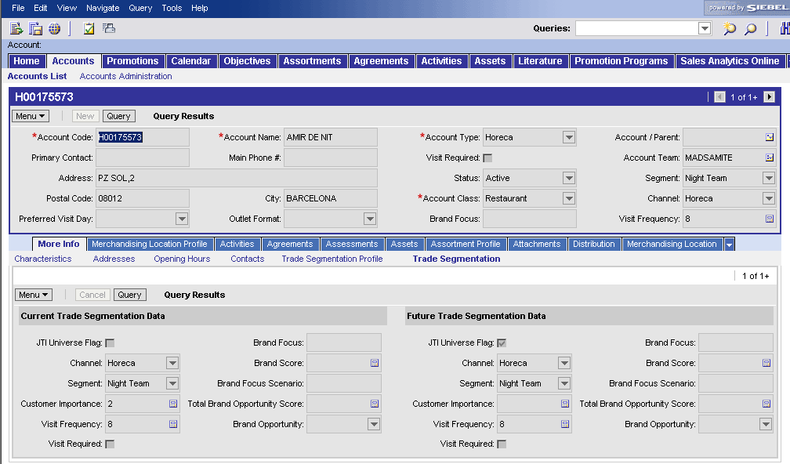
I.2 Determine JTI universe and prioritize clusters
Current and future Trade Segmentation attributes
Step 3: The Operational Planner and the Trade Marketer can review the future (next year’s) new Trade Segmentation values in the Account/More Info/Trade Segmentation view in Siebel Sales. (incl. channel & segments)

Slide 16

I.3 Determine size of resources and allocate
Tool steps
How do you determine size of resources and
allocate (HR, materials)
Better practice process steps
  Define customer contact strategy
  Set visit frequency & manage trade marketers capacity*
  Define territory coverage plan (~ Territory Management)
  Initiate/terminate 3rd party relationships (contracts)
  Plan trade marketer requirements for trade marketing cycle
Siebel
Sales
Siebel Analytics
Siebel
Sales
Siebel Sales support for BP process steps
Siebel Analytics support for BP process steps
*Trade Segmentation functionality

Slide 17
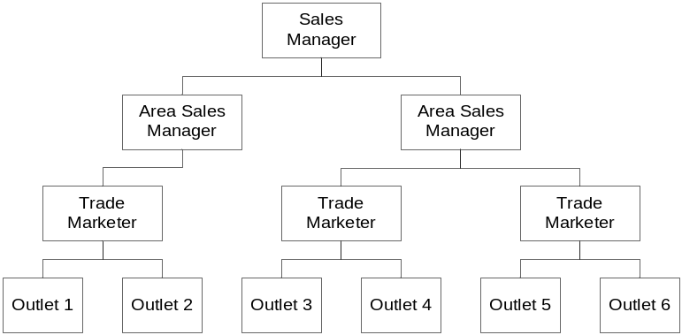
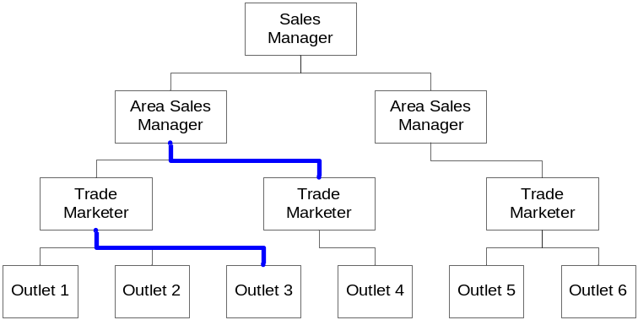
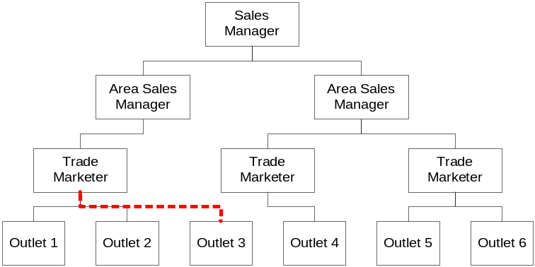
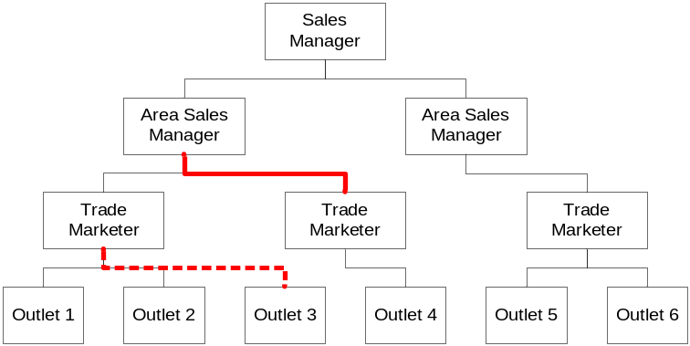
I.3.3 Define Territory Coverage Plan
Territory Management
How are the current Territories updated (minor)?
Minor Updates on the current Territories
Export Territories from the “Administration – Group” screen to the “Territory Management” screen through an interface.
Make minor updates in the “Territory Management” screen
Import the changes into the “Administration – Group” screen through an interface
Current
Territories
1
Revised
Territories
Planned
Territories
3
2

Slide 18
I.3.3 Define Territory Coverage Plan
Territory Management
How are the current Territories updated (mass)?
Current
Territories
1
Planned
Territories
2
3
c
5
4
External Tool*/External Agency/ Siebel Analytics
3
Revised
Territories
Mass Updates on the current Territories
Export Territories from the “Administration – Group” screen to the “Territory Management” screen through an interface.
Export Territories into the Flat Files for the load into the external tool
Modify Territory Data in external tool
Import changes into “Territory Management” screen
Import changes into “Administration – Group” screen
*Today: the countries choose their own tool. Future: global tool

Slide 19
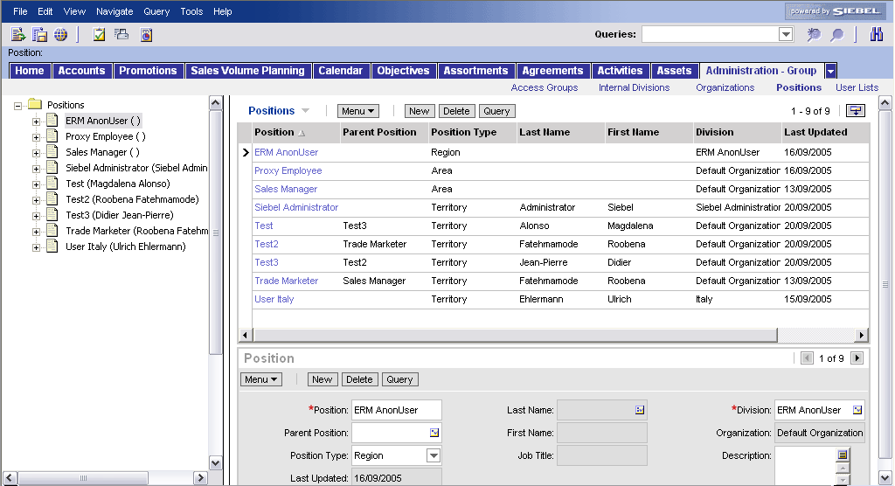
I.3.3 Define Territory Coverage Plan
Territory Management – Current territories
How can you review the current Territories?
  Territory Hierarchy
Note:
Positions (= regions, areas, territories) are not created/deleted by the Operational Planner but by the administrator
2
1
3
Review & Export Territory Hierarchy
Go to the Positions view in the Administration – Group screen
Review list of Regions, Areas and Territories (“Position”)
Review the Territory Hierarchy (“Parent Position”)

Slide 20
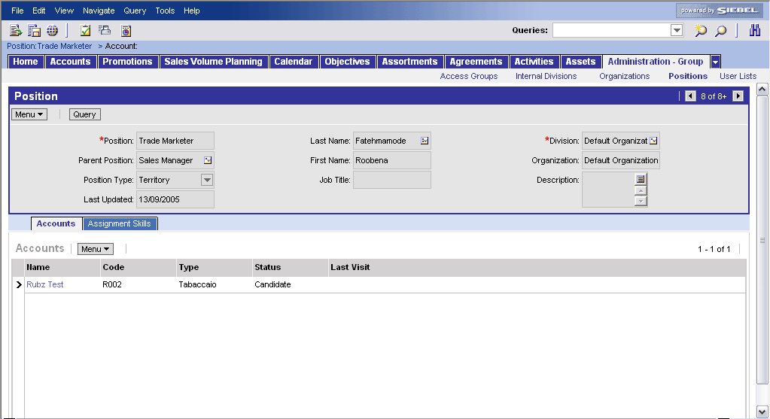
I.3.3 Define Territory Coverage Plan
Territory Management – Current territories
How can you review the current Territories?
  Territory Outlets
Review Territory Outlets
Details of a Territory can be reviewed in the form applet
The list of outlets related to the territory can be reviewed in the list applet
1
2

Slide 21
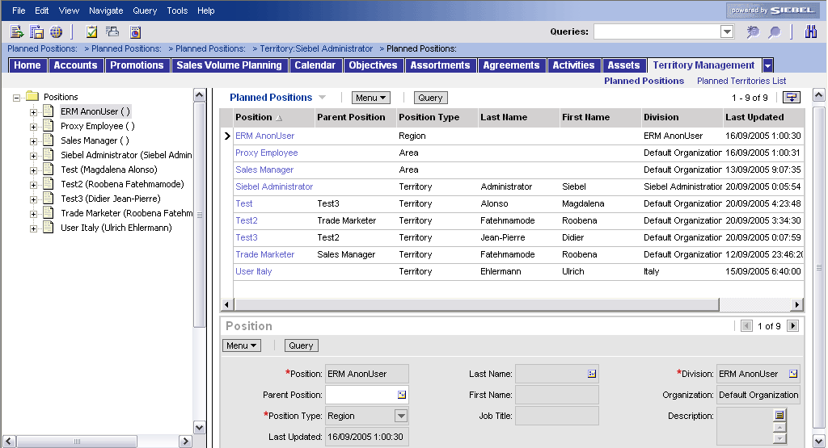
I.3.3 Define Territory Coverage Plan
Territory Management – Planned territories
How can you update the Territories Hierarchy?
  Change “Parent Position”
Change Parent Position
Go to the Planned Positions view in the Territory Management screen
Update the Parent Position
1
2

Slide 22
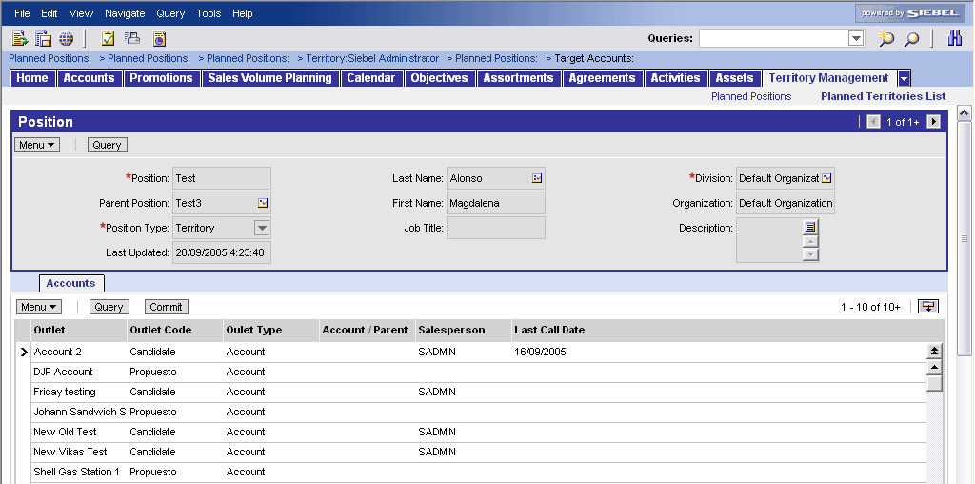
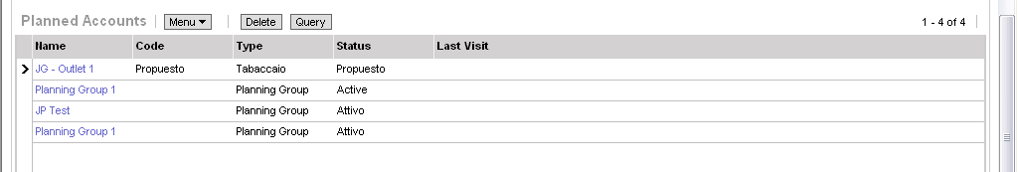
I.3.3 Define Territory Coverage Plan
Territory Management – Planned territories
How can you update the Territory Hierarchy?
  Change list of Outlets for a certain territory
Change list of Outlets
Delete an outlet from the current list (select an outlet and push the “delete” button)
Add an outlet to the current list (select outlet and push the “commit” button)
2
1

Slide 23
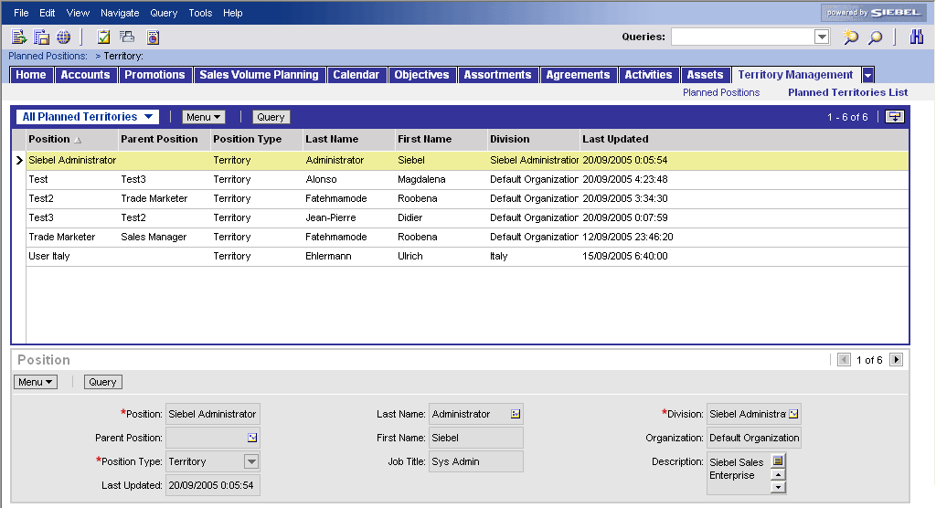
I.3.3 Define Territory Coverage Plan
Territory Management – Planned territories
How can the current territories be updated with the planned territories?
  Interface to import
Import Planned Territories
Go to the Planned Territories List view in the Territory Management screen
Go to the All Planned Territories view and check the Planned Territories
Trigger the import interface by contacting AM
1
2

Slide 24
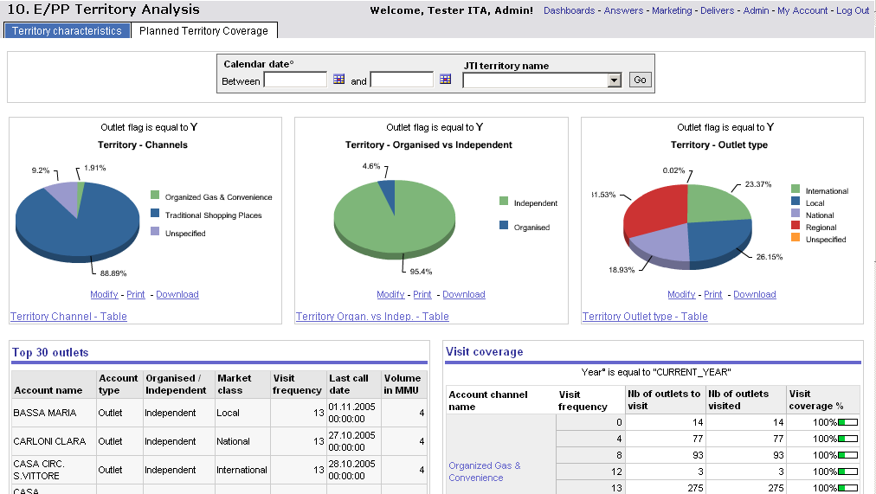
I.3.3 Define Territory Coverage Plan
DB: Planned Territory Coverage
In this DB the Operational Planner can analyse the
characteristics of the new territories in terms of
outlet type, visit coverage, volume, etc.
This analysis will serve as input for defining the Fixed
Coverage Plan criteria (see FCP)
2
3
4
5
Review Planned Territory Coverage
Navigate within Siebel Analytics to the “Operational Planning/Determine Visit Frequency & Field Force Reqs” dashboard
Open the DB page “Planned Territory Coverage”
Select the JTI Territory
If wanted, select a certain time frame
Press “Go” and analyze

Slide 25
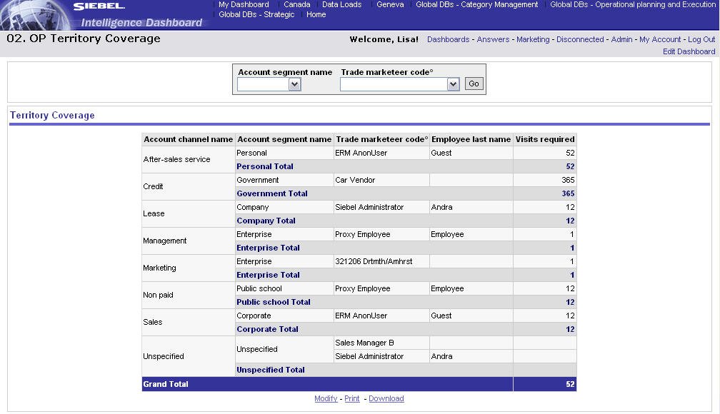
I.3.3 Define Territory Coverage Plan
DB: Territory coverage
To analyze how many visits are required for each
Trade Marketer, the Operational Planner can
consult the Territory coverage dashboard in Siebel
Analytics. This is important input to calculate the
FCP criteria (see FCP)
Siebel Analytics
1
Review the future territory coverage
Focus your analysis by using the filters on “Segment” and “Trade Marketer level”. Press “Go”

Slide 26
I.3.3 Define Territory Coverage Plan
Fixed coverage planning (FCP)
How do you determine the fixed coverage planning
and create the routes for the Trade Marketers?
  After visit frequencies and territories have been
  defined, all the outlets to be visited are put on a
  timeline per Trade Marketer (automatised process). This timeline is called a “route”. Every Route consists of a list of outlets to be visited in a certain week The routes are stored in the “Routes” screen in Siebel Sales.
  The Operational Planner requests Application Maintenance to execute the FCP procedure (routes creation) (on a yearly basis or ad-hoc)
  The FCP functionality
    creates 52 weekly routes per Trade Marketer (for one year)
    Daily routes are bundled in a weekly route header using the offset day
    Leveling within one week is done based on the capacity of the trade marketer and the number of outlets already scheduled (x Visit Coefficient). Outlets are scheduled on the best available day (geographically close and <TMer capacity)
    Weekly route headers are created per territory(TMer) for each week in the cycle.
    Outlets are linked to the (weekly) routes based on their visit frequency.
    Outlet visits are balanced across all routes. For every week of the planning year there is (approximately) the same number of accounts available to be visited.

Slide 27
I.3.3 Define Territory Coverage Plan
Fixed coverage planning (FCP): visit coefficient
The FCP is based on following criteria:
  JTI Universe Flag (see “Determine JTI Universe”)
  Visit Frequency (see “Load Trade Segmentation Attributes”)
  Geography/Region
  Capacity of the Trade Marketer (value entered/maintained by local Admin)
  Account Visit Coefficient →defined by the TMer when creating account in Sales
  Preferred visit day
Definition "Account Visit Coefficient"
  Account Visit Coeffient is a number which indicates how many times the visit at one account takes longer than the average visit duration of a normal account.
  E.g. Normal account
    Average visit duration of normal account = 1hour (incl. travel)
    Visit coefficient for normal account = 1
    Time for the visit = average duration x account visit coefficient = 1h x 1 = 1 hour
  E.g. Special account (due to travel constraints, access characteristics, etc.)
    Average visit duration of normal account = 1hour (incl. travel)
    Visit coefficient for special account = 1,5
    Time for the visit = average duration x account visit coefficient = 1h x 1,5 = 1,5h

Slide 28
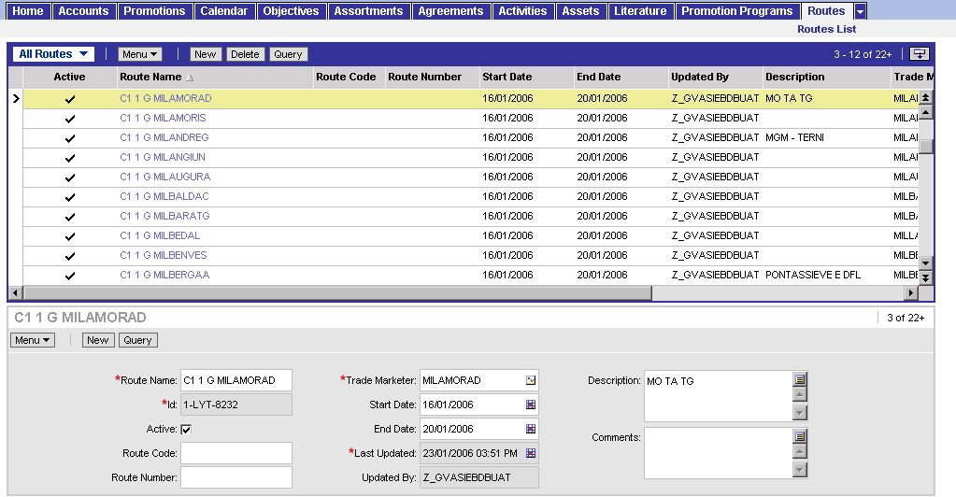
I.3.3 Define Territory Coverage Plan
Fixed coverage planning (FCP)
How to review the list of routes?
Review list of routes
Go to the “All Routes” view in the “Routes” screen
Review the list of routes in the list applet at the top
Drill down on a “Route Name” to see the outlets within this route (see next slide)
1
2
3

Slide 29
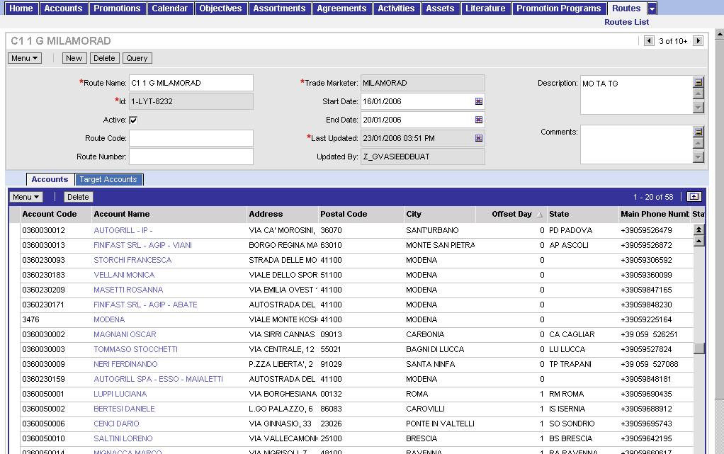
I.3.3 Define Territory Coverage Plan
Fixed coverage planning (FCP)
How to review the list of outlets assigned to a route?
Review list of outlets within a route
The Trade Marketer can update the routes
E.g. delete an outlet from a route
The Trade Marketer can modify the “Offset Day” to re-assign a day of the week to the outlet; 0 = Monday, 1 = Tuesday, …
1
2

Slide 30
I.4 Communicate objectives & instructions
Tool support
How do you determine size of resources and
allocate (HR, materials)
Better practice process steps
  Translate the Channel / Segment / Cluster and Account
  guidelines and objectives into individual guidelines and
  objectives per Trade Marketer
  Translate the overall territory objectives into outlet
  objectives
  Provide implementation guidelines and link Trade
  Marketing activities objectives to compensation
  Provide a set of personal objectives (skill building, …) per
  Trade Marketer and link them with a variable compensation
  package
  Communicate to Trade Marketer objectives, guidelines
  and related incentives
Siebel
Sales
Siebel
Sales
Siebel Sales support for BP process steps

Slide 31
I.4 Communicate objectives & instructions
I.4.1 – I.4.2 Defining Objectives
The Operational Planner, before defining
objectives and activities he will assist the Category
Developer in targetting the accounts in scope for
the execution of the new assortment & space
propositions or promotion and merchandising plans
  How the communication occurs to accounts is slightly different for assortment plans (planning groups) versus promotions and merchandising programs (“commit” in Target Accounts view). The process is explained in detailed in the according modules.
  The selection of target accounts is the same, either by creating a cluster, a target list or a manual selection.
In the following slides the principles of clusters, target lists and the communication of promotion and merchandising programs will be reviewed.

Slide 32
I.4 Communicate objectives & instructions
Selecting target accounts
Various options are possible for targeting outlets for
an assortment plan / promotion or merchandising
  For a channel/segment
    Sales*: Planning Group: Select a “Segment”
    Recommendation: save the selected accounts as
    target list and then apply to the planning group (easy for later use such as updates on assortment plan)
  For outlets belonging to one parent account (Key Account)
    Sales: Planning Group: Select a “Parent Account” (e.g. Shell)
    Recommendation: save the selected accounts as target list and then apply to the planning group (easy for later use such as updates on assortment plan)
  For a cluster
    Siebel Marketing: create more complicated clusters based on queries and the combination of one or more data sources (Consumer data, survey data, etc.)
    Sales : load the cluster as Target List, then apply Target List within the Planning Group
  For one account (Strategic Account) → Select one account
* Siebel Sales Consumer Goods

Slide 33
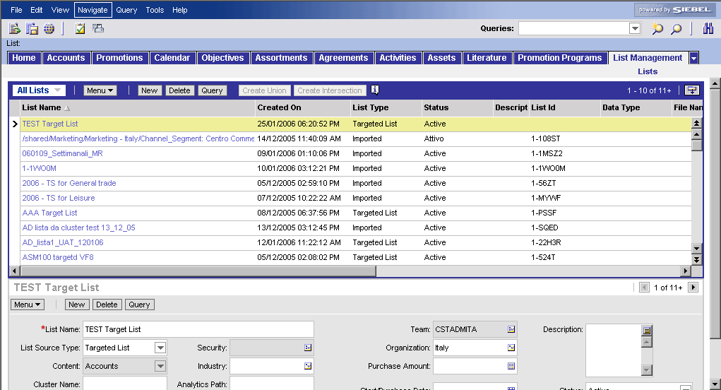
I.4 Communicate objectives & instructions
Target list - Selecting target accounts
Recommendation: use target lists to re-use the
same accounts for other targetting or for
post-analysis
How do you create target lists in Siebel Sales
Step 1: Create a new Target List
1
2
3
Create a target list
Navigate to the Site Map
Opent the List Management/Lists view
Press the New button
Name the new target list
Select “Targeted List” as List Source Type
4
5
* Siebel Sales Consumer Goods

Slide 34
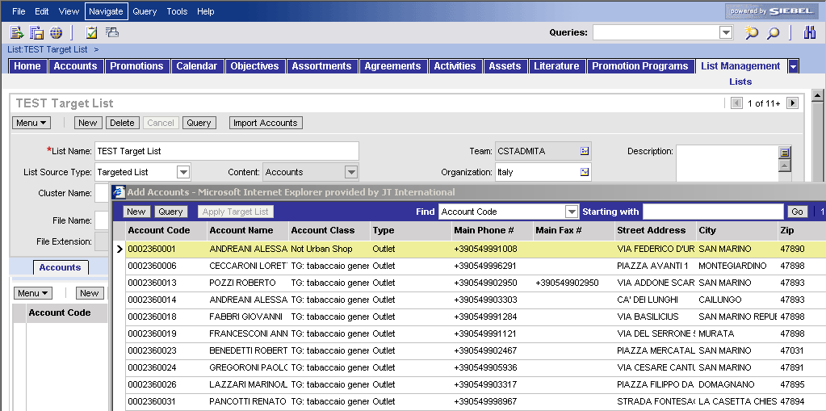
I.4 Communicate objectives & instructions
Target list - Selecting target accounts
Step 2: Select the accounts that belong to the list
Select the accounts for the target list
Drill down on the record of the new target list
-> the accounts applet opens
Press the “New” button and select the accounts
Tip1: use Ctrl button to select various accounts
Tip2: use Query to narrow your search
Press OK
1
2
* Siebel Sales Consumer Goods

Slide 35

I.4 Communicate objectives & instructions
Clusters: Creation and usage - Tool steps
How do you define and use a cluster?
Clusters are created in Siebel Marketing (accessible
via Site Map) and can be applied in Sales for Planning
Groups, target list for Objectives, Promotion &
Merchandising Programs, Planned Territories, etc.
Create a cluster of outlets (segment)
Marketing
Create a List and import Accounts
Sales
Go to any view with Target Accounts (e.g. planning group)
Select accounts (Target List or manual) and apply

Slide 36
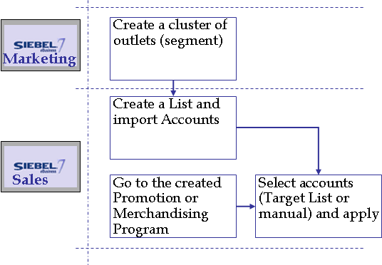
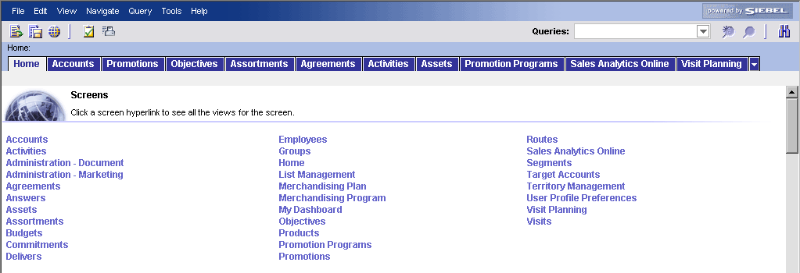
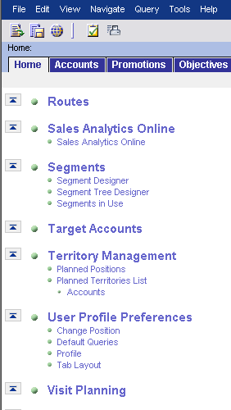
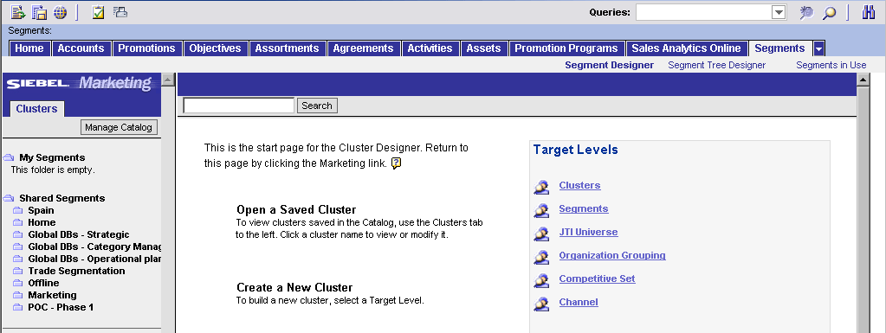
I.4 Communicate objectives & instructions Create a cluster
Pre-requisite: Create a cluster (1/3)
Access to “Segment Designer”
In Siebel Sales, click on Site Map icon
Click on Segments
Click on Segment Designer to start the Siebel Marketing application
Choose the Clusters target level.
1
2
3
4

Slide 37
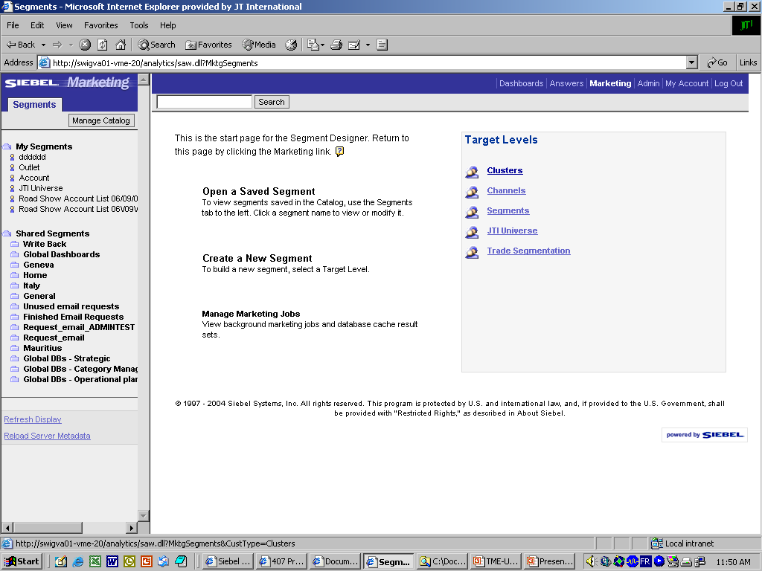
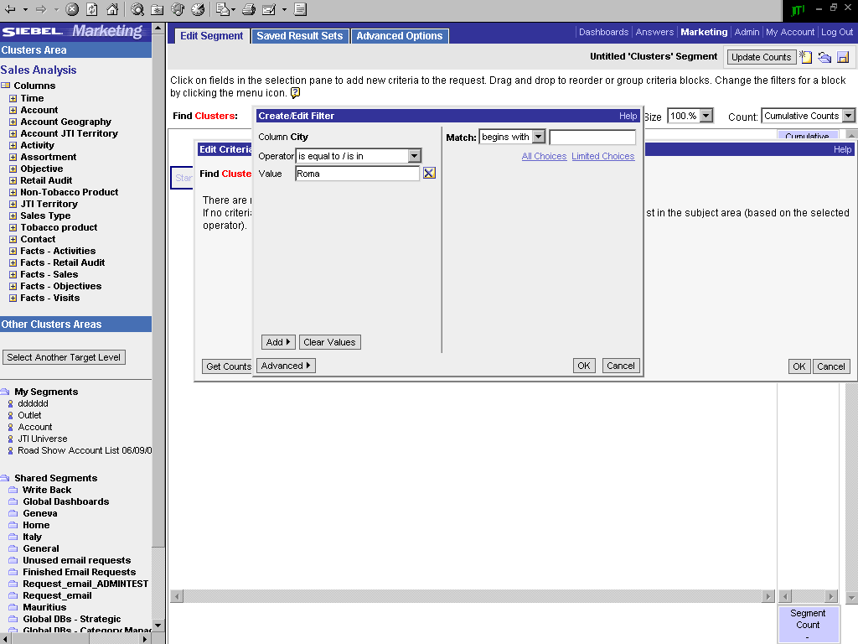
I.4 Communicate objectives & instructions Create a cluster
Pre-requisite: Create a cluster (2/3)
1
2a
2b
2c
2d
Clusters created by the user
Select the cluster level to be created
To create a new cluster, define the variables:
  Choose among variables
  For each variable, define search method: Operator
  And enter value
  Click OK
Shared clusters

Slide 38
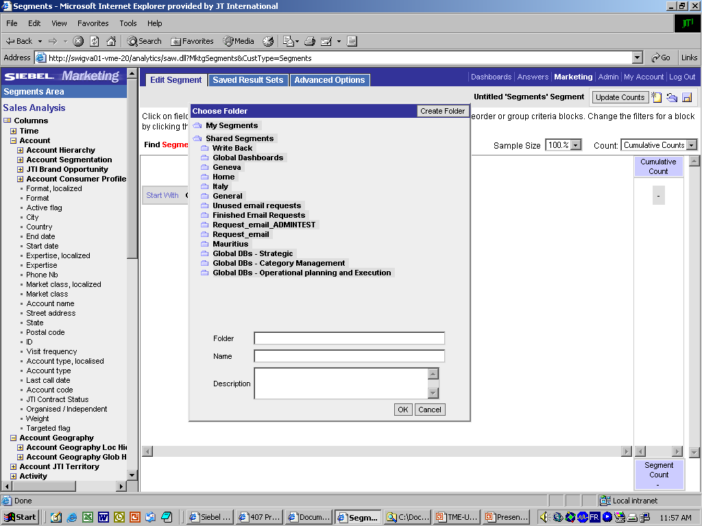
I.4 Communicate objectives & instructions Create a cluster
Pre-requisite: Create a cluster (3/3)
  Save the created cluster
2
1
2a
Click the Save icon
Save:
  Select a folder where you want to save the Cluster
  BE AWARE! The value shown in the field “Folder” is equal to the value you will have to add later in the field “Analytics Path” when importing the cluster within a Target List in Siebel Sales
  Enter name for the cluster
  BE AWARE! The value shown in the field “Name” is equal to the value you will have to add later in the field “Segment Name” when importing the cluster within a Target List in Siebel Sales
2b

Slide 39
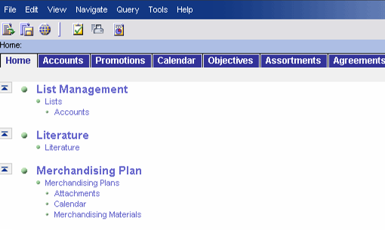
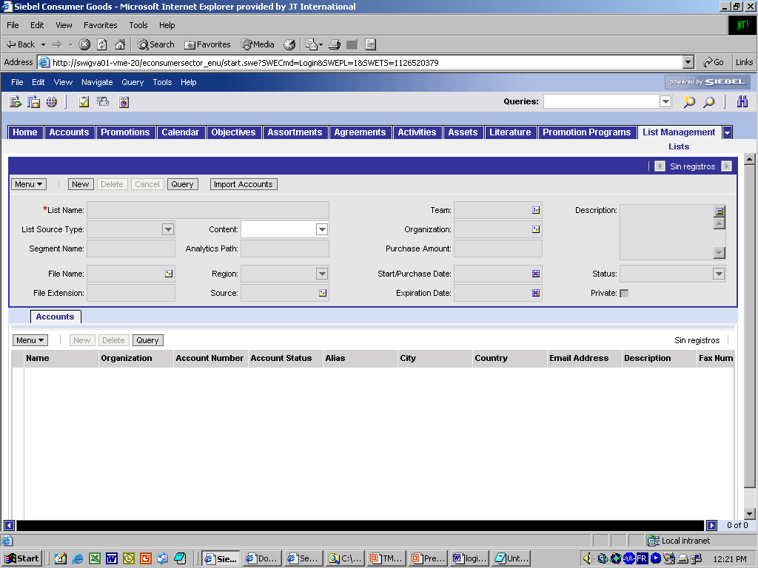
I.4 Communicate objectives & instructions Create a target list for the cluster
Pre-requisite: Import the cluster in Siebel Sales
  Within Sales you create a Target List and load all
  the accounts from the cluster within („Import“)
1
2a
2b
Log into Siebel Sales CG
Navigate to the List Management functionality
  Go to the site Map
  Go to the List Management/ Lists/Accounts view
Create a new list that will contain the cluster
  Click New
  Enter List Name
  Choose value ‘Targeted List’ in the List source type drop-down menu
  Enter the Analytics Path for Siebel to import the correct values (The “Folder”)
  Enter exact name of the Segment created in Analytics
Click ‘Import Accounts’
The accounts are listed in the bottom list-applet
3a
4
3b
3c
3e
3d
5

Slide 40
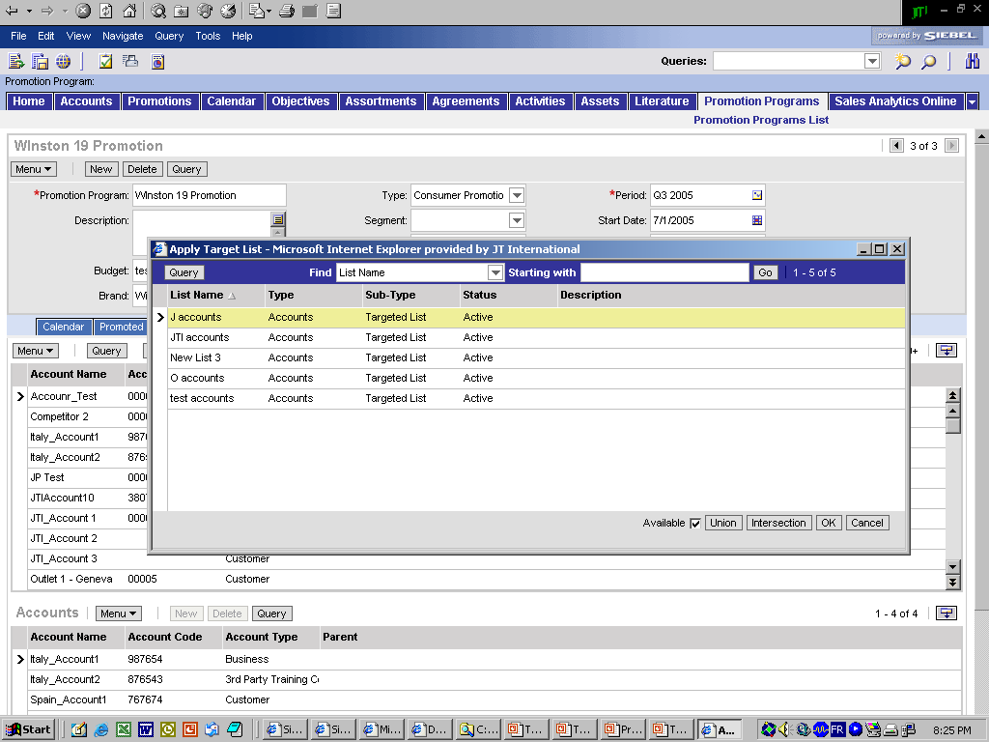
I.4 Communicate objectives & instructions Apply the target list to a promotion program
Add accounts to the Promotion Program (example of use
also applicable to planning groups, etc.)
2a
Add accounts in the Promotion Program
Navigate to the Target Account view
Picking a Target List
  Click on the Target List icon.
  In the pick-applet window, select the List and click OK
The middle list-applet of accounts is replaced by only the accounts contained in the Target List
Select all accounts (Ctrl+A)
Click the ‘Commit’ button
The accounts are now added in the bottom list, and applied to the Promotion Program
Detail-applet of the record
2b
List-applet of accounts
3+4
Process described for the creation of a promotion program. The process for creating Assortment & Space propositions and Merchandising plans are described in detail in the according modules
List-applet of accounts
applied to the Promotion Program
6

Slide 41
I.4 Communicate objectives & instructions Apply the promotion program via “Commit”
Apply the promotion program
  By pressing the „Commit“ button in the „Target
  Accounts“ view of the Promotion Program, the tool
  creates Promotions (duplicates) for all the targeted
  accounts. This is the actual communication within the tool.
Commit
Promotion Program
Promotion ‘X’ for account 1
Promotion Program ‘X’
With n accounts
Promotion ‘X’ for account 2
Promotion ‘X’ for account 3
Promotion ‘X’ for account 4
Promotion ‘X’ for account n
Promotion Program screen
Promotions screen

Slide 42
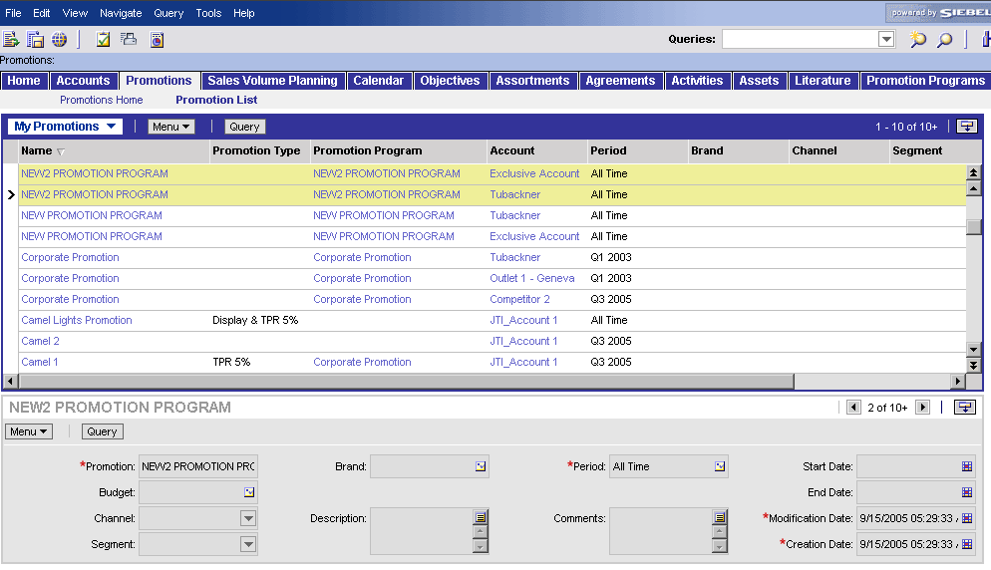
I.4 Communicate objectives & instructions
Check deployment
Check program deployment
  In the ‘Promotions’ screen, the created Promotion
  Program should appear as many times as there are
  outlets in the Promotion Program
1a
1b
2b
2c
2a
Check Promotions and Promotions Programs per Accounts
Navigate to the Promotion List view
  Click on the Promotion screen tab
  Click on the Promotion List link
Check program deployment
  The column ‘Name’ displays the names of the Promotions per account (by default, name is the same as the Promotion Program)
  The column ‘Promotion Program’ displays the related Promotion Program
  The column ‘Account’ displays the accounts related to each Promotion

Slide 43
I.4 Communicate objectives & instructions
I.4.1 – I.4.2 Defining Objectives
One of the main day-to-day activities of the Operational
Planner is, based on the guidelines of the Category
developer, creating and assigning objectives and TM
activities
What are the different Objective Types within the
Siebel Applications?
  Strategic Objectives
    Brand Objectives
    Channel Objectives
    Segment Objectives
    Strategic Account Objectives
  Operational Objectives
    Region Objectives
    District Objectives
    Area Objectives
    Territory Objectives
    Outlet Objectives
  Trade Marketing Activities
Operational Planner

Slide 44
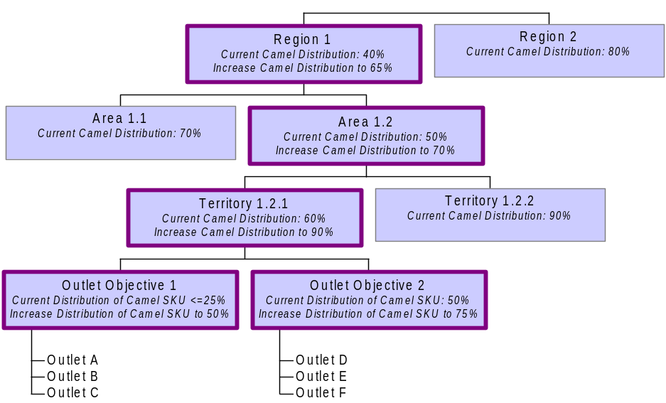
I.4 Communicate objectives & instructions
I.4.1 – I.4.2 Defining Objectives
Trade Marketing Activities
Brand Objective:
Define
Promotion, Merchandising,
"Increase Awareness for Camel"
Assortment and Space
Channel 1
Channel 2
Channel 3
Trade Marketing
Trade Marketing
Strategic Objectives
Current Level of distribution: 85%
Current Level of distribution 50%
Current Level of distribution 95%
Increase distribution to 70%
Activity 1
Activity 2
Translate
Review Assortment
Segment 2.1
Segment 2.2
Segment 2.3
Segment 2.4
Support
Current Level of distribution: 45%
Current Level of
distribution: 75%
Current Level of
distribution: 75%
Current Level of dist. 30%
Increase Awareness to 75%
Increase dist. to 70%
Operational Objectives

Slide 45
I.4 Communicate objectives & instructions
I.4.1 – I.4.2 Defining Objectives
Naming convention for objectives, budgets and programs
  It is recommended to implement a naming convention for objectives, budgets, assortmentment plans, promotion and merchandising programs.
  This improves user-friendliness both for navigation within Siebel Sales, but also for analysis purposes in Siebel Analytics.
  E.g.: Objective naming for Channel Objectives
    Naming template: FYXX-BRAND-CHANNEL/SEGMENT-OBJECTIVE
    "FY06-CAMEL LIGHT-HORECA-INCREASE SOM +5%“

Slide 46
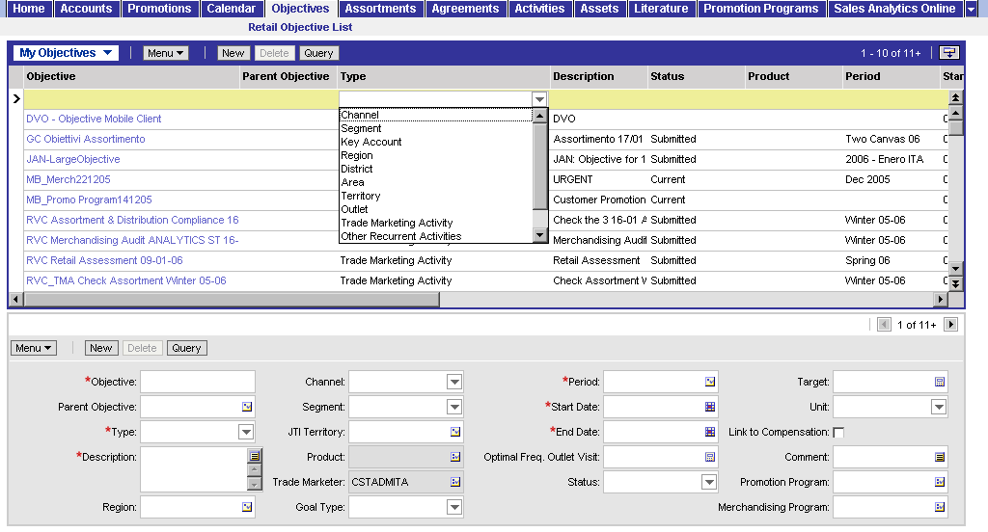
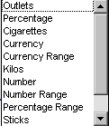
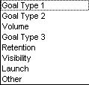
I.4 Communicate objectives & instructions
I.4.1 – I.4.2 Defining Objectives /non-TM Activities
How do you create JTI Territory Objectives ??
Create a JTI Territory Objectives
Go to screen “Objectives”
Click “New” button in the form applet at the bottom
Fill out first the mandatory fields
  Fill in name of the new Objective
  Choose the Type (Region, Area, Territory, Outlet)
  Provide a description of the Objective
  Allocate the JTI territory
  Indicate the goal type
  Pick a Period (Start Date & End Date are automated)
  Detail the Target and the according unit of measurement
3a
3d
3f
3g
3b
3c
3e

Slide 47
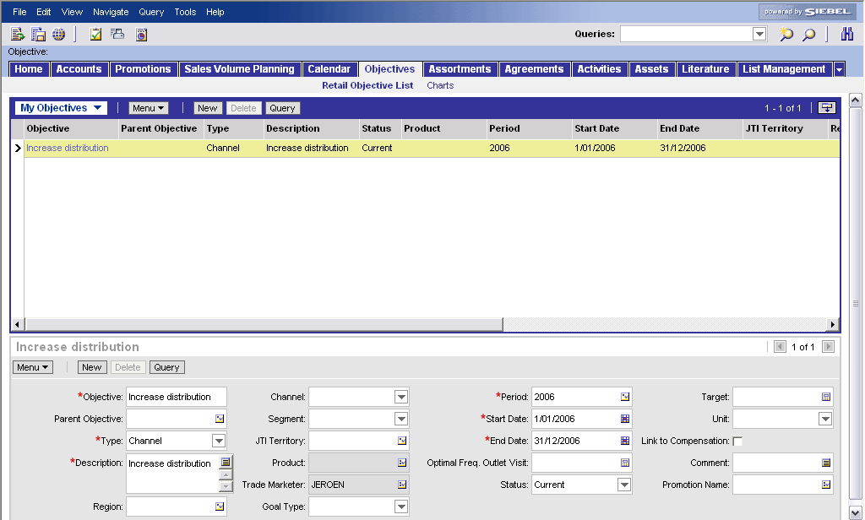
I.4 Communicate objectives & instructions
I.4.1 – I.4.2 Defining Objectives / TM Activities
How do you create TM Activities?
  This objective describes the overall goal of the
  supporting activities and it can be linked to a
  promotion program E.g. "Support promotion
  XXX by placing material YYY and checking compliance"
1
Create a new Trade Marketing Activity
Go to screen “Objectives”
Click “New” button in the form applet at the bottom
Fill out first the mandatory fields
  Fill in name of the new Objective
  Choose the TM Activity type
  Provide a description of the TM activity
  Indicate the goal type
  Pick a Period (Start Date & End Date are automated)
2
3e
3a
3b
3c
3d

Slide 48
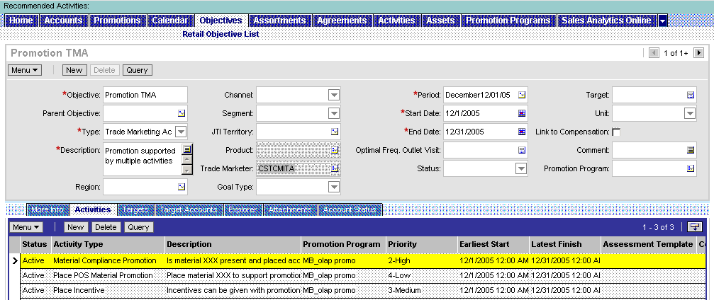
I.4 Communicate objectives & instructions
I.4.1 – I.4.2 Creating visit activities
Create Activities for the Trade Marketer
  The Operational Planner creates very specific, detailed
  activities that support the TM Activity objective and
  the implementation of for example a promotion
  program. These will be organized by visit.
  E.g. typical promotion supporting activities are:
    on 04.11.05 go to outlet XXX and place item 1234 (Poster) in the store
    at the latest by 30.11.05 go to outlet XXX and check the promotion compliance
Create a (visit) activity
Go to the “Activities” view in the “Objectives” screen
Click the “New” button in the list applet at the bottom
Fill out first the mandatory fields
  Fill in the Activity Type
  Fill in the Description
  Promotion Program or Merchandising Program if applicable
  Priority
Specify Earliest Start and Latest Finish Date in case not equal to the period of the TM Activity objective (should be between Start and End date of this period)
1
2
Make sure the difference between Start and End date is at least a week in order to be taken into account by the CAP procedure (automated visit scheduling)
3
4

Slide 49
I.4 Communicate objectives & instructions
I.4.1 – I.4.2 Creating visit activities
Possible in-store visit activity types in Siebel Sales CG:
  General activity (non-specific):
    In Store Activity
  Promotion related activities:
    Place POS Material Promotion
    Place Incentive
    Material Compliance Promotion
  Merchandising related activities:
    Place POS Material Merch.
    Material Compliance Merch.
  Assortment & Space related activities (Audits):
    Retail Audit
    Retail Audit Location
    Merchandising Audit
  Other activities:
    Retail Assessment
    Opportunity

Slide 50
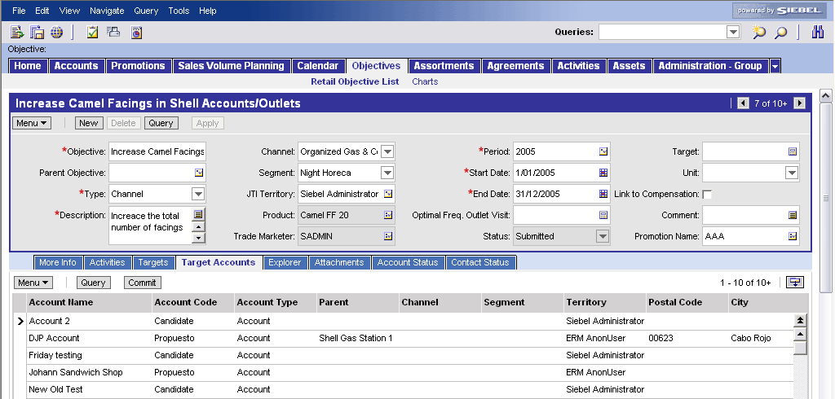
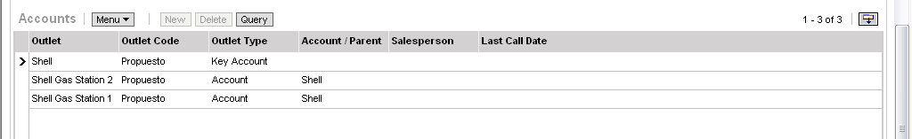
I.4 Communicate objectives & instructions
I.4.1 – I.4.2 Targetting Objective & TM Activities
How do you add a list of outlets to an Objective
or TM Activity?
Align with the Category Developer !!!
E.g. Best practice is to use the same Target List that the Category Developer has used to for example create the different Merchandising Plans (“Commit” button in Merchandising Programs). This way all the targeted accounts for the Merchandising Plan will also receive the related TM activity
3
1
2
Add a list of Outlets to an objective
Go to the “Target Accounts” view in the “Objectives” screen
Select an Outlet in the list applet in the middle and push the “commit” button. Repeat this until you have committed al the Outlets you want. (you can also use Target List functionality here)
Push the “Apply” button to make the activities (related to this objective) available in the “Activities” view in the “Accounts” screen for all the target outlets.

Slide 51
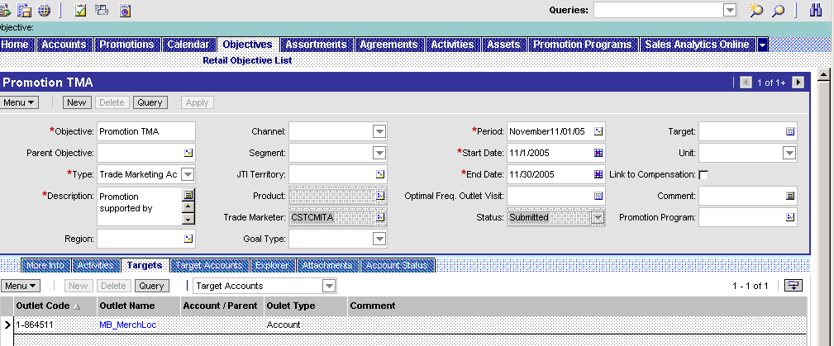
I.4 Communicate objectives & instructions
I.4.1 – I.4.2 Targetting Objective & TM Activities
Communicate (apply) the activities to the accounts
  Once the target accounts selected by the commit
  button in the “Target Accounts” view, you need
  to communicate the TM Activity objectives and its
  activities to the selected target accounts by pressing
  the “Apply” button in the “Targets” view.
3
1
Communicate the TM Activity objective and its visit activities to the target accounts
Go to the “Target” view
Review the final selection of Target Accounts
Press the “Apply” button
2

Slide 52
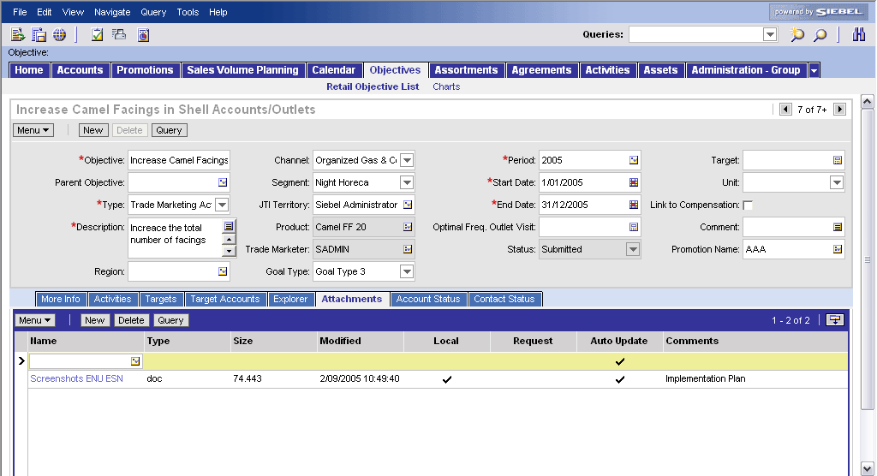
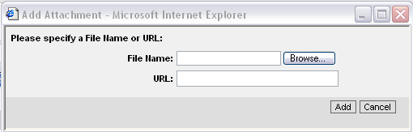
I.4 Communicate objectives & instructions
I.4.1 – I.4.2 Defining Objectives / TM Activities
How do you add an attachment to an Objective?
Add an attachment to an objective
Go to the “Attachments” view in the “Objectives” screen
Click the “New” button in the list applet at the bottom.
Click the Pick Applet icon in the “Name” field
Browse for a file, click open and click the “Add” button
2
1
3
4

Slide 53
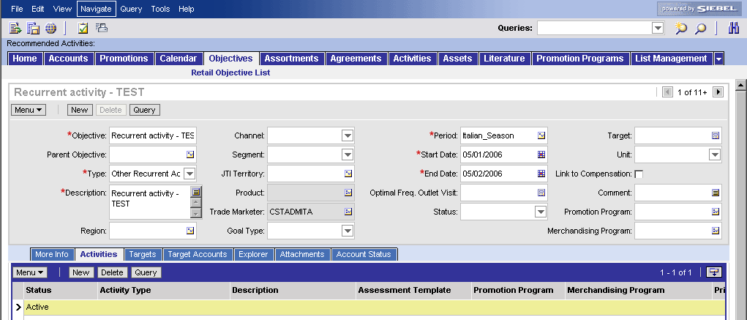
I.4 Communicate objectives & instructions
I.4.1 – I.4.2 Defining Objectives / TM Activities
How do you define and track recurrent activities
in Siebel Sales?
Recurrent activities, so non-cycle specific, need to
be linked to an objective with objective type
“Other recurrent activities”
Create recurrent activities
Navigate to the “Objectives” view
Describe the new objective
  Click on “New”
  Fill out the “Objective name”
  Indicate the “Other recurrent activities” as objective type
  Describe the objective
  Indicate the valid time period
Drill down on the objective name
Open the activities tab
Add new activities as described before
!!! Flag the required column” !!!
1
2a
2b
2e
2c
2d
4
5

Slide 54
I.4 Communicate objectives & instructions
I.4.5 Communicate Cycle Activity Planning (CAP)
Cycle activity planning occurs every cycle
  When new TM Activities are created
  The Operational Planner requests Application Maintenance to execute this CAP procedure
  (automised process in Siebel after all cycle TM activities
  have been created, taking into account the Fixed Coverage planning)
Cycle Activity Plan (CAP) is performed per cycle
  Determines the visits which are necessary to perform the TM activities per territory for the trade marketer and ensures the activities are linked to the visit.
CAP consists of the following steps:
  Activity Scheduling:
  Updating routes based on the outlet activities generated through Trade Marketing Activities (Objectives) within the CAP period.
  Create Visits:
  Scheduling of visits based on the account route information and linking of the relevant non routine activities to the visit. This is a separate execution to the ‘Activity Scheduling’ before and can be re-executed any time within one cycle in order to create visits for newly created Trade Marketing Activities.
  Schedule Routine Activities:
  Linking of routine activities to the Visits in the cycle.

Slide 55
I.4 Communicate objectives & instructions
I.4.5 Communicate Cycle Activity Planning (CAP)
CAP input parameter:
  FCP (Routes information)
  Cycle start and end date
  Market/List of territories
  Trade Marketing Activities which were linked
  to outlets (via the apply functionality of objectives - objective/Activity/Account Targeting). Activities need to cover at least one whole week to be considered for scheduling.
  Days off for unscheduled visits
Leveled distribution:
  ‘Preferred visit day’ of outlet will be taken into account if available.
Output:
  Newly created visits and activities linked to it

Slide 56
I.4 Communicate objectives & instructions
I.4.5 Communicate Cycle Activity Planning (CAP)
FCP versus CAP
  Impact of loading daily routes
Using FCP
Loading Daily Routes
Creates daily routes for one Trade Marketer
The algorithm ensures that:
  One account will be visited maximum once per week.
  Every outlet will be scheduled based on the future visit frequency.
  The Trade Marketer will not have more outlets in his route than he can visit in one week
  Optimization of the travel time is restricted to the use of the “Preferred Visit Day”.
Daily routes need to be provided by the markets or an external tool
Data provided to be loaded in Siebel needs to ensure that the rules for FCP are being met:
  One account can only be visited maximum once a week.
  The outlet visit frequency need to be met per outlet (yearly basis).
  The Trade Marketer capacity needs to be taken into account (Not more outlets can be scheduled as he can visit per day).
  The scheduling of outlets need to done by optimizing the travel time (Geographic optimization).
  No routes should be loaded for public holidays and vacation of the Trade Marketer (linked to that territory).

Slide 57
Tools exercises for Operational Planning
#1: Define Operational Objectives
Log on to the Siebel Application
  Use the following Login details:
    User ID: CSTOP1ESN or CSTOP1ITA
    Password: CSTOP1ESN or CSTOP1ITA
    Connect to: http://tme-uat.jti.com/econsumersector_enu
Define Region Objective
  Go to the Objectives screen
  Create a Region Objective
    Objective: Increase Camel distribution (Region)
    Type: Region
    Description: Increase level of distribution from 40% to 70%
    Period: 2005
    Target: 70
    Unit: Percentage
    Region: pick any region
    Goal type: Volume

Slide 58
Tools exercises for Operational Planning
#1: Define Operational Objectives
Define Area Objective
  Create an Area Objective and link it to a Region Objective
    Objective: Increase Camel distribution (Area)
    Parent Objective: Increase Camel distribution (Region)
    Type: Area
    Description: Increase level of Awareness from 50% to 70%
    Period: 2005
    Target: 70
    Unit: Percentage
    Area: pick any area belonging to the region you selected before
    Goal type: Visibility
Define Territory Objective
  Create a Territory Objective and link it to an Area Objective
    Objective: Increase Camel distribution (Territory)
    Parent Objective: Increase Camel distribution (Area)
    Type: Territory
    Description: Increase level of Awareness from 60% to 90%
    Period: 2005
    Target: 90
    Unit: Percentage
    Territory: Select any Trade Marketer’s territory
    Goal type: Visibility

Slide 59
Tools exercises for Operational Planning
#1: Define Operational Objectives
Define Outlet Objective
  Create an Outlet Objective and link it to an Territory Objective
    Objective: Increase Camel distribution (Outlet)
    Parent Objective: Increase Camel distribution (Territory)
    Type: Outlet
    Description: Increase level of Awareness from 50% to 75%
    Period: 2005
    Target: 75
    Unit: Percentage
    Outlet: Select any outlet belonging to the territory selected earlier
    Goal type: Visibility
Define list of outlets
  Go to the "Target Accounts" view in the "Objectives" screen for the outlet Objective "Increase Camel distribution (Outlet)"
  Select outlets in the middle applet and push the "commit" button to define them as target accounts for the Outlet Objective
  (they appear in the bottom applet)
  (A pre-selection in the middle applet can be made by applying a target list (if there is a target list defined))

Slide 60
Tools exercises for Operational Planning
#1: Define Operational Objectives
Review Outlet Objective in the Accounts screen
  Go to the "Accounts" screen
  Query for one of the outlets that you "committed" to the Outlet Objective in the previous steps
  Go to the "Objectives" view (within the "Accounts" screen) for this outlet
  (the Outlet Objective "Increase Camel Distribution (Outlet)" appears in the list applet at the bottom)

Slide 61
Tools exercises for Operational Planning
#2: Define Trade Marketing Activity&Target Accounts
Define TM Activity
  Go to the Objectives screen
  Create a TM Activity
    Objective: Perform Retail Audit
    Type: Trade Marketing Activity
    Description: Retail Audit TM Activity
    Period: 2005
Define (visit) activities supporting the TM Activity
  Go to the "Activities" view in the "Objectives" screen for the TM Activity "Perform Retail Audit"
  Add a new Activity
    Activity Type: Retail Audit
    Description: Perform Retail Audit
    Priority: 2-High
    Required: <flag>
    Routine: <flag>

Slide 62
Tools exercises for Operational Planning
#2: Define Trade Marketing Activity&Target Accounts
Define list of outlets
  Go to the "Target Accounts" view in the "Objectives" screen for the TM Activity created in the previous steps
  Select outlets in the middle applet and push the "commit" button to define them as target accounts for the TM Activity
  (they appear in the bottom applet)
  (A pre-selection in the middle applet can be made by applying a target list (if there is a target list defined))
Apply the TM Activity
  Push the "Apply" button on the top applet in the "Target Accounts" view

Slide 63
Tools exercises for Operational Planning
#2: Define Trade Marketing Activity&Target Accounts
Review TM Activity and (visit) Activity in the "Accounts" screen
  Go to the "Accounts" screen
  Query for one of the outlets that you "committed" to the TM Activity in the previous steps
  Go to the "Objectives" view (within the "Accounts" screen) for this outlet
  (the TM Activity "Perform Retail Audit" appears in the list applet at the bottom)
  Go to the "Activities" view (within the "Accounts" screen) for this outlet
  (the activity "Retail Audit" appears in the list applet at the bottom)

Slide 64
I.5 Manage 3rd parties
Tool support
How do you manage 3rd parties
Better practice process steps
  Define the areas of responsibility
  Link objectives and KPIs to remuneration
  Sign an agreement

Slide 65
I.6 Administer and support sales & service
Tool support
How do you manage and support sales & service?
Better practice process steps
  Determine visit schedule
  Manage / Follow-up individual trade marketer productivity
  Manage performance of the trade marketing team
  Manage assets
  Enable report creation and distribution
  Training
Siebel
Sales
Siebel Analytics
Siebel Analytics

Slide 66
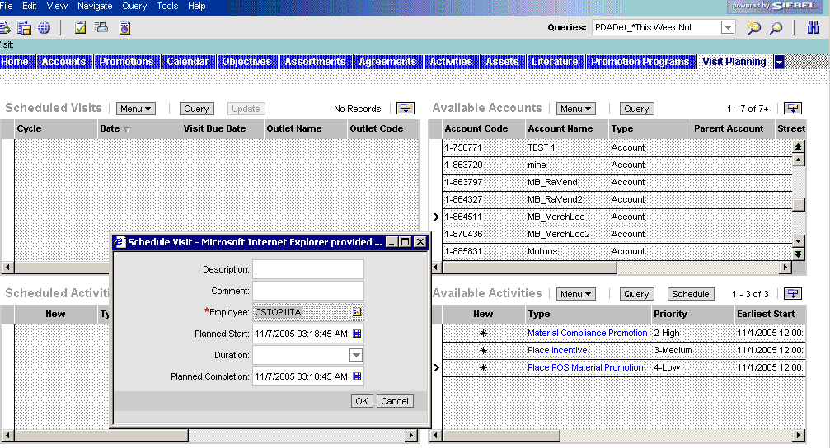
I.6 Administer and support sales & service
I.6.1 Determine visit schedule
Group the activities by visits and plan them
  This is a process the Operational Planner
  executes each cycle and which is automated
  -> Described in process I.4.5. It is possible to still
  schedule a visit separately in the “Visit Planning” screen.
Compose and schedule a visit
Go to the “Visit Planning” screen
In the right upper list applet “Available accounts” select one of the targeted accounts
The earlier defined promotion visit activities will appear as “Available activities”. Select the ones you want to schedule a visit for
Press the “Schedule” button
Fill out the descriptive fields, add the person who needs to execute and press “OK”
1
2
4
3
5

Slide 67
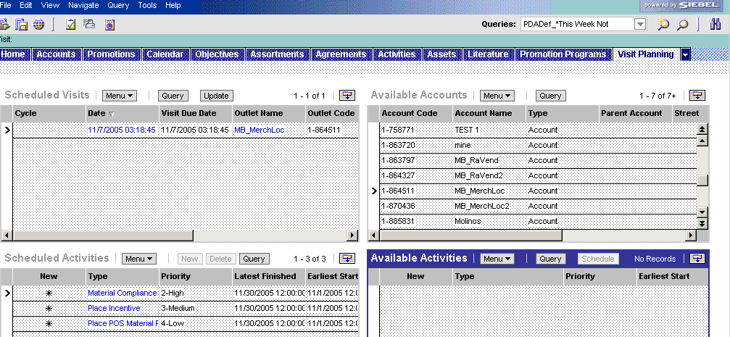
I.6 Administer and support sales & service
I.6.1 Determine visit schedule
Review the activities and add if needed
  Review the activities for the scheduled visit(s)
  If new active activities are created within the
  period of the visit, you press “Update” to include.
Add new activities to the visit
(first create visit activity as described before)
Select the account in the right upper applet
The new activity will popup in the bottom applet “Available Activities”
Select the scheduled visit to which you want to add the activity
Press the “Update” button
The visit will appear in the left bottom applet “Scheduled visits” and disappear in the right bottom applet “Available activities”
4
3
1
5
2

Slide 68
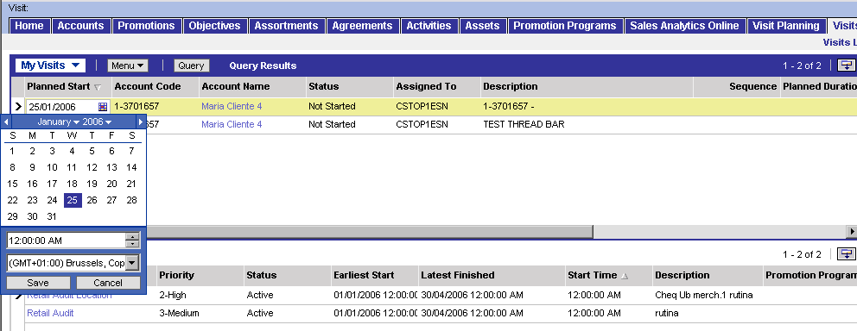
I.6 Administer and support sales & service
I.6.1 Determine visit schedule: reassign (1/2)
Reassign visits (e.g. Trade Marketer ill)
  The Trade Marketer responsible for a visit to
  an account is by default the one who has the
  account within his territory.
  Visits can be rescheduled or reassigned to another Trade Marketer
  without changing territory settings.
1
2
Reschedule the visit
Go to the Visits screen
Search for the Visit you want to change and click on the “Planned Start” field
Pick another date and click “Save”
3

Slide 69
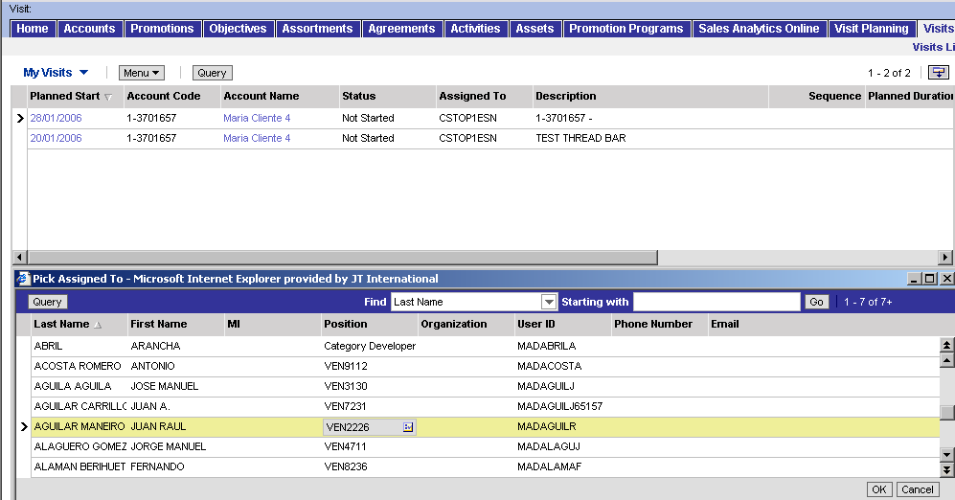
I.6 Administer and support sales & service
I.6.1 Determine visit schedule: reassign (2/2)
Reassign visits (e.g. Trade Marketer ill)
  After re-assigning the new Trade Marketer
  will see the visit in his “My Visits” list
1
2
Reassign the visit
Go to the Visits screen
Search for the Visit you want to change and click on the “Assigned to” field
Pick another Trade Marketer and double click or click “OK”
3

Slide 70

I.6.2-3 Follow-up individual & Trade Marketer team performance
The Operational Planner can use the same
Siebel Analytics dashboards which are used
for the Execution capability by the Area Sales
Manager
  Operational Planners can use the “Field Force
  Effectiveness & Efficiency” dashboard within Execution to analyze individual Trade Marketer and team performance, etc.
  The functionality of these dashboards are described within the “Execution at PoP/PoC” module

Slide 71
I.7 Evaluate Operational Planning effectiveness Tool support
How do you evaluate Operational Planning
effectiveness ?
Better practice process steps
  Review Trade Marketing activities performance against
  objectives
  Evaluate the effectiveness of objectives setting for the
  Trade Marketing activities and Trade Marketers
  Evaluate 3rd parties
  Review contact strategy and resource allocation at market
  level and take corrective actions
  Document and share lessons learned
Siebel
Sales
Siebel Analytics
Siebel Analytics

Slide 72
I.7 Evaluate Operational Planning effectiveness
Dashboards (cfr execution)
The Operational Planner can use the same
Siebel Analytics dashboards which are used
for the Execution capability by the Area Sales
Manager
The Operational Planner can use following Execution dashboards to analyze the achievement of the objectives and activities defined by the Operational Planner, etc.
  Visit Report
  Outlet Sales
  Territory Analysis
  Survey
  Contracts
  Field Force effectiveness & Efficiency
The functionality of these dashboards are described within the “Execution at PoP/PoC” module

Slide 73
Summary : Learning objectives of this module
You are now able to
  Understand how the TME applications support the BP processes for Operational Planning
  Create Clusters in Siebel Marketing and use them in Siebel Sales CG
  Create and manage territories, operational objectives, trade marketing activities, visit activities and visits in Siebel Sales CG
  Monitor field force efficiency en effectiveness in Siebel Analytics
Notes:
Review key objectives as documented on the slide with your participants.

Slide 74
Next steps after the training session
Based on what you have learned, you can
  Familiarize with the Siebel applications
  Execute the Self-Paced exercises available on the TME University Portal
  Localize training material
  Train other users in your market
  Attend more upcoming intermediate and advanced trainings to complete your knowledge of Operational Planning

